Slide 1
Stats: R
Notes:
R is an open source software programming language and a software environment for statistical computing and graphics.
If Tableau Desktop (version 8.1 and later) has a connection to an Rserve server, which is a server that allows applications to access R functionality, you can use a set of four functions to pass R expressions to an Rserve server and obtain a result.

Slide 2
Installing Rserve
Download R: http://cran.rproject.org/bin/windows/base/
Download Rstudio: http://www.rstudio.com/products/rstudio/download/
Script:
Install.packages(“Rserve”)
Library(Rserve)
Rserve()
When you run Rserve from the R Console, it remains resident in memory, and is able to serve requests from Tableau workbooks even if you close the R Console. You can use Windows Task Manager to verify that Rserve is running.
Notes:
Question: If I want to publish workbook containing R function to tableau server, what shall I do?
Similarly, if you upload a workbook that contains R functionality to Tableau Server, then Tableau Server must have a connection to an Rserve server. R is not supported for Tableau Reader or Tableau Online.
Not possible:
Can’t export data from Tableau into R directly to run a new model outside of using the SCRIPT functions
Visualisations created in R can’t be imported directly to Tableau

Slide 3
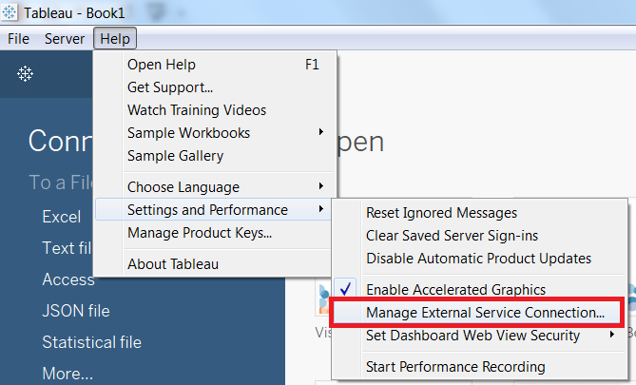
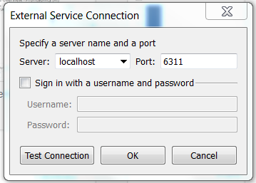
Connecting to Rserve
The connection info is located under Help.
Rserve is automatically set to port 6311.
Notes:
More information at http://www.rforge.net/Rserve/doc.html

Slide 4
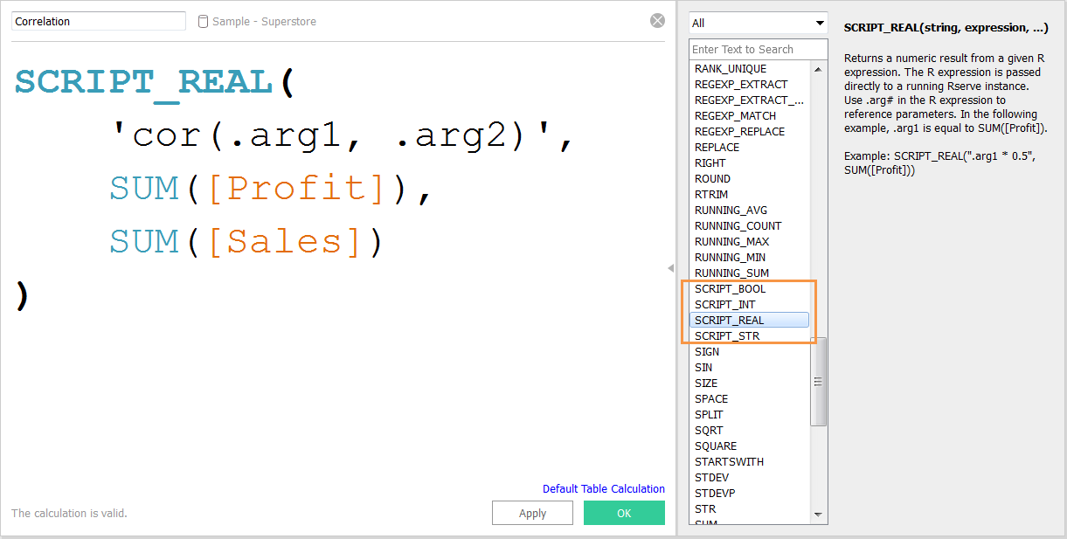
Syntax

Slide 5
Syntax
“SCRIPT_” calculated fields are Table Calculations

Slide 6
Tableau expects a certain data type back from R
SCRIPT_BOOL(…) |  | Boolean, Logical
SCRIPT_INT(…) |  | Integer
SCRIPT_REAL(…) |  | Float, Double, Real
SCRIPT_STR(…) |  | String, Character
Notes:
Functions are distinct in the type of result they return: Boolean, integer, real number, string
The expression is passed directly to a running external service instance. In R expressions, use .argn (with a leading period) to reference parameters (.arg1, .arg2, etc.).
.arg1 is equal to SUM([Profit])
SCRIPT_BOOL(“is.finite(.arg1)”, SUM([Profit]))
True for store IDs in Washington state, and False otherwise
SCRIPT_BOOL(‘grep1(“.*_WA”, .arg1, perl=TRUE)’, ATTR([Store ID]))

Slide 7
Tableau expects a certain data type back from R
SCRIPT_BOOL(…) |  | Boolean, Logical
SCRIPT_INT(…) |  | Integer
SCRIPT_REAL(…) |  | Float, Double, Real
SCRIPT_STR(…) |  | String, Character
Notes:
In R expressions, use .argn (with a leading period) to reference parameters (.arg1, .arg2, etc.)
In this R example, .arg1 is equal to SUM([Profit]):
SCRIPT_INT("is.finite(.arg1)", SUM([Profit]))
In the next example, k-means clustering is used to create three clusters:
SCRIPT_INT('result <- kmeans(data.frame(.arg1,.arg2,.arg3,.arg4), 3);result$cluster;', SUM([Petal length]), SUM([Petal width]),SUM([Sepal length]),SUM([Sepal width]))

Slide 8
Tableau expects a certain data type back from R
SCRIPT_BOOL(…) |  | Boolean, Logical
SCRIPT_INT(…) |  | Integer
SCRIPT_REAL(…) |  | Float, Double, Real
SCRIPT_STR(…) |  | String, Character
Notes:
The expression is passed directly to a running external service instance. In R expressions, use .argn (with a leading period) to reference parameters (.arg1, .arg2, etc.)
In this R example, .arg1 is equal to SUM([Profit]):
SCRIPT_REAL("is.finite(.arg1)", SUM([Profit]))
The next example converts temperature values from Celsius to Fahrenheit.
SCRIPT_REAL('library(udunits2);ud.convert(.arg1, "celsius", "degree_fahrenheit")',AVG([Temperature]))

Slide 9
Tableau expects a certain data type back from R
SCRIPT_BOOL(…) |  | Boolean, Logical
SCRIPT_INT(…) |  | Integer
SCRIPT_REAL(…) |  | Float, Double, Real
SCRIPT_STR(…) |  | String, Character
Notes:
The expression is passed directly to a running external service instance. In R expressions, use .argn (with a leading period) to reference parameters (.arg1, .arg2, etc.)
In this R example, .arg1 is equal to SUM([Profit]):
SCRIPT_STR("is.finite(.arg1)", SUM([Profit]))
The next example extracts a state abbreviation from a more complicated string (in the original form 13XSL_CA, A13_WA):
SCRIPT_STR('gsub(".*_", "", .arg1)',ATTR([Store ID]))

Slide 10
Syntax
This is where the R
magic happens
Notes:
Tableau doesn’t evaluate the text

Slide 11
Syntax
Data to be sent from Tableau to R
Aggregated Dimension(s)
Aggregated Measure(s)
Parameter(s)

Slide 12
Syntax
.arg1

Slide 13
Syntax
.arg2

Slide 14
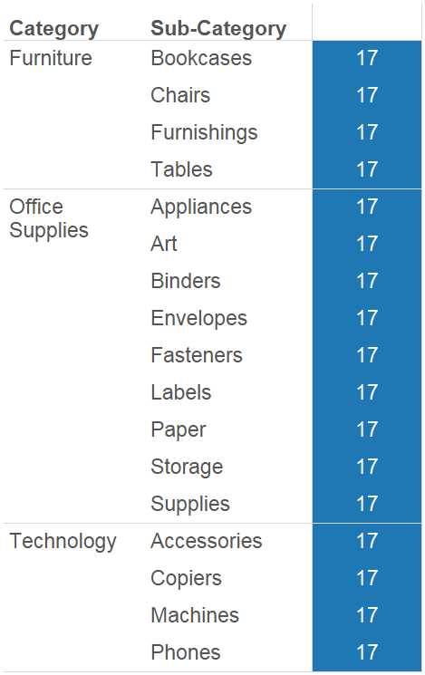
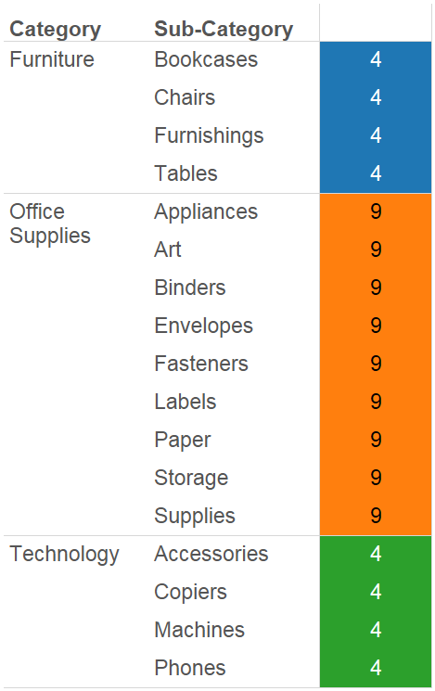
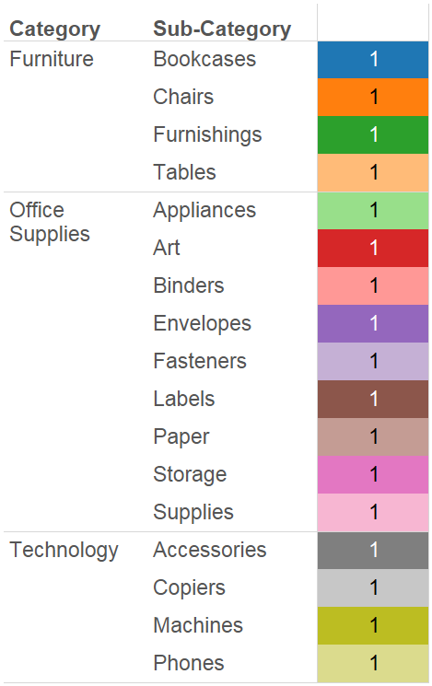
Table Down
Pane Down
Cell

Slide 15
Handling Common Errors
Error Type 1: Check how Tableau is sending data
Table calculations
Error Type 2: Check how Tableau is receiving data
Tableau wants a certain data type back
Tableau wants a vector back (utilize stored data inside objects)

Slide 16
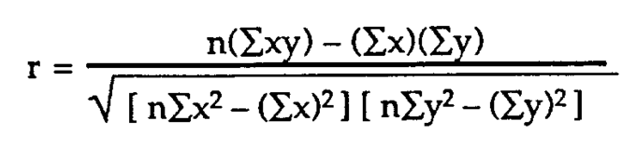
Correlation
Correlation refers to any of a broad class of statistical relationships involving dependence between 2 random variables.
Examples:
Height and Weight
Maximum Building Height and a Cities GDP
Days Past due date and your Boss’ happiness
Notes:
How does a change in one variable effect another variable.
A positive correlation means that as X increase Y increases.
A negative correlation means that as X increase Y decreases.
The correlation value ranges from -1 to 1. Where -1 is total negative correlation and 1 is total positive correlation
This IS do-able inside of tableau but requires a long calculation. However, keeping this inside of Tableau will keep up the performance of your workbook

Slide 17
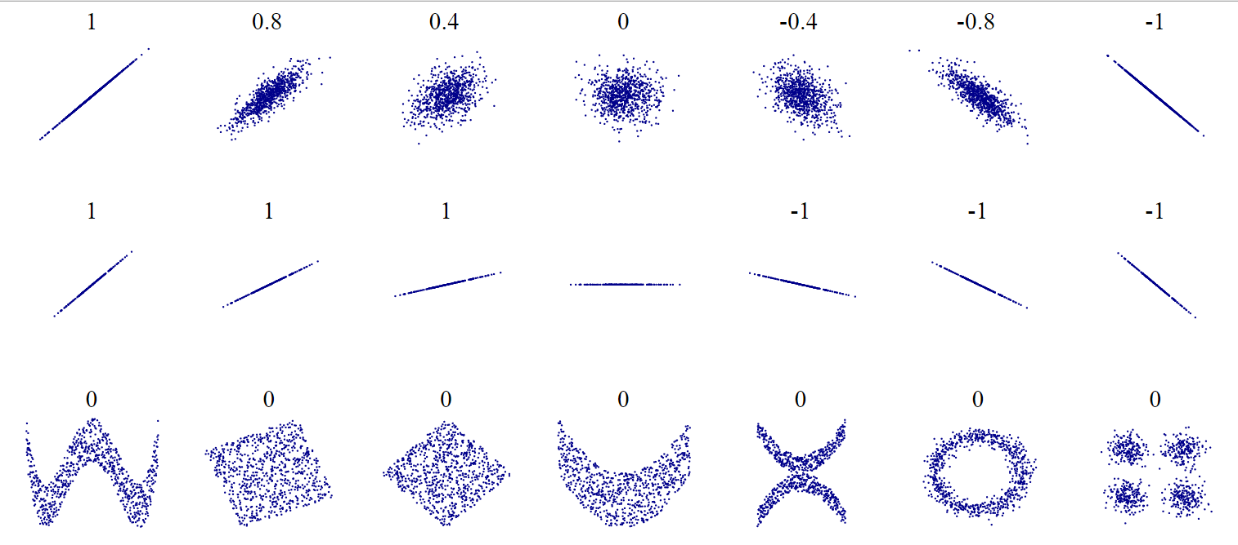
Correlation
Notes:
A positive correlation means that as X increase Y increases.
A negative correlation means that as X increase Y decreases.
The correlation value ranges from -1 to 1. Where -1 is total negative correlation and 1 is total positive correlation
This IS do-able inside of tableau but requires a long calculation. However, keeping this inside of Tableau will keep up the performance of your workbook
How does a change in one variable effect another variable.

Slide 18
Challenge: Negative Correlation w/ R
Find which Region and Customer Segment has a negative Sales and Profit relationship
Hint:
Cor(.arg1,.arg2)
Change the compute using

